Slide 1
REMOTE SENSING OF MONTHLY
EVAPOTRANSPIRATION USING DATA FUSION
NEAR DISNEY WILDERNESS PRESERVE
Aaron Evans
Nov. 8, 2014

Slide 2
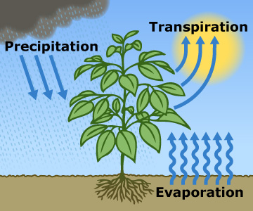
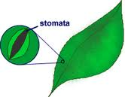
What is Evapotranspiration?
Evapotranspiration (ET): Combination of Evaporation and Plant Transpiration
Transpiration: Release of vapor from stomata
Notes:
33
2

Slide 3
ET vs. Precipitation
Florida has Intermediate ET/P
30 yr ET/P

Slide 4
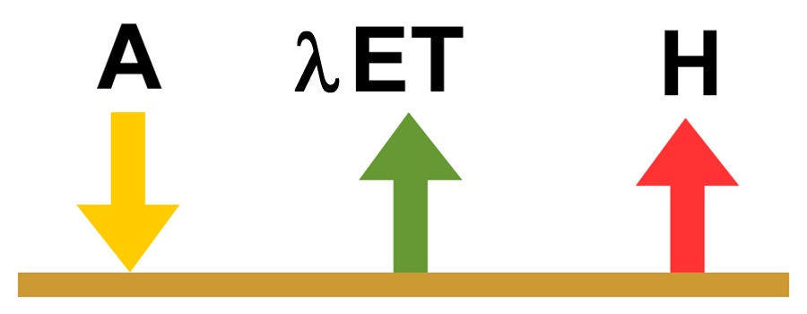
Energy Balance
λ ET = EF A
A = Available Energy (Radiation)
EF = Evaporative Fraction of Energy
Divide Problem Between Finding:
1) Energy
2) EF

Slide 5
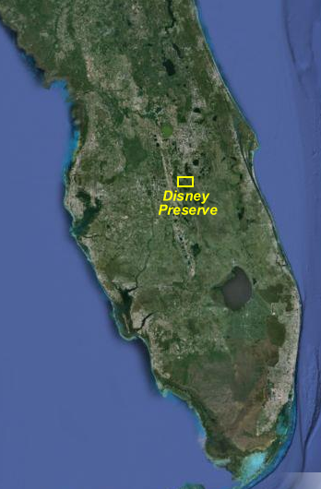
Disney Wilderness Preserve
Mostly Grass
Shallow Water Table
Chosen Because It Has
Flux Towers

Slide 6
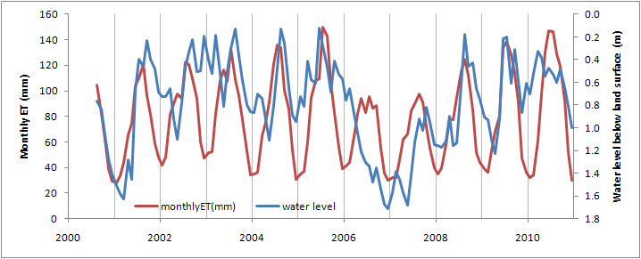
Flux Tower Monthly ET
2000-2011: USGS measured ET via
Eddy Covariance Method
2006-2007: Very Dry Years

Slide 7
OBJECTIVE
Use Remote Sensing to Estimate Monthly ET
Over Multi Year Period
Validate Against Flux Tower

Slide 8
USGS PET Maps
USGS has produced
2 km maps from
GOES/FAWN
Available Energy
(Accounts for CLOUDS)
→ “Potential” ET
Not “Actual” ET
Depends on Water/Vegetation
Availability
from: https://eros.usgs.gov/doi-remote-sensing-activities

Slide 9
Actual ET
Produce “Actual” ET maps
Produce EF maps using LANDSAT
-> multiply by USGS Daily Available Energy
Notes:
33

Slide 10
MODIS Operational ET Product
MOD 16: Global Actual ET (1 km)
Complex Model -> Assumes Many Parameters
11 Sets of Parameters for Only 11 Biome Types
Will These Work For Our Study Area?
Notes:
33

Slide 11
Thermal Remote Sensing
ET Strongly Related To
Surface Temperature
Use Residual Method:
Find a, b via Calibration
ET = A – H
H = a + b T_{s}
Notes:
33

Slide 12
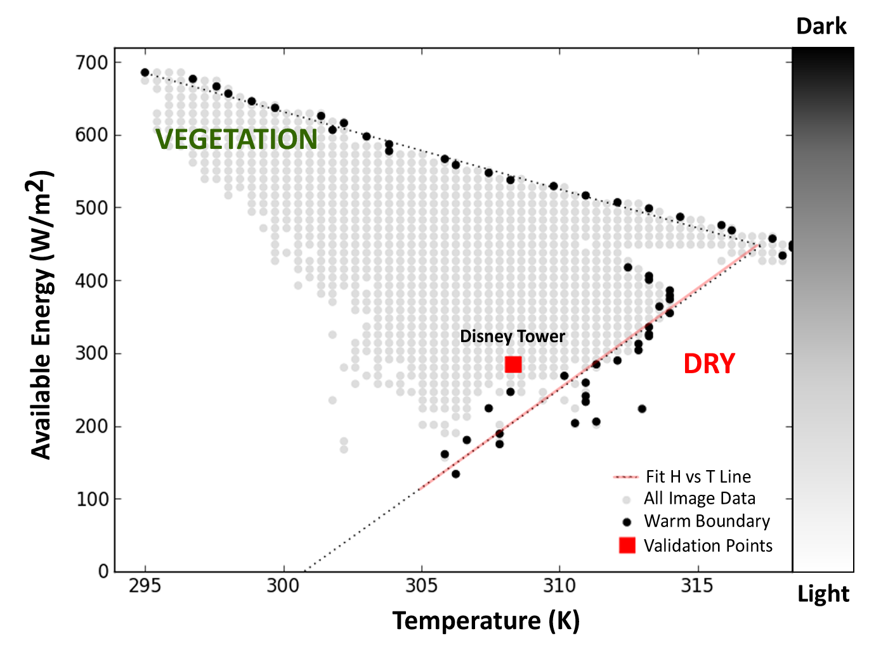
Automated Calibration
Performed for LANDSAT
Notes:
33

Slide 13
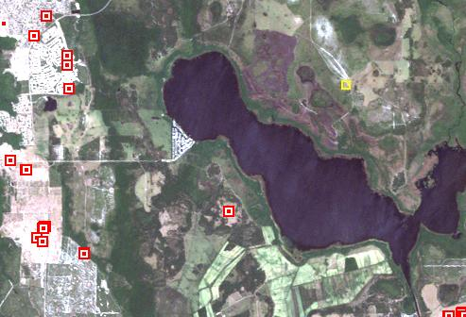
Dry Pixels
Performed for Every Image
Notes:
33

Slide 14
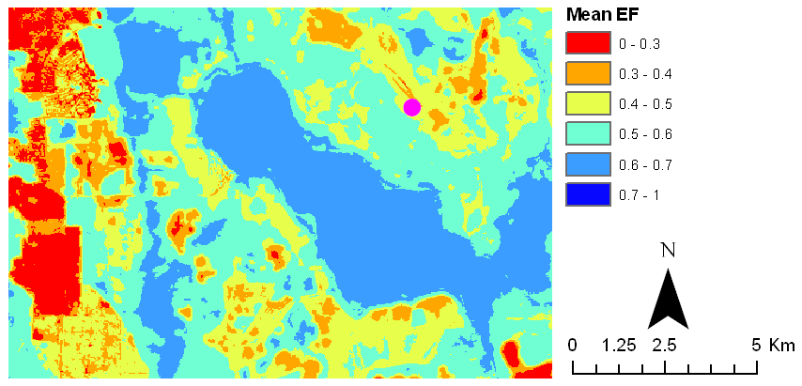
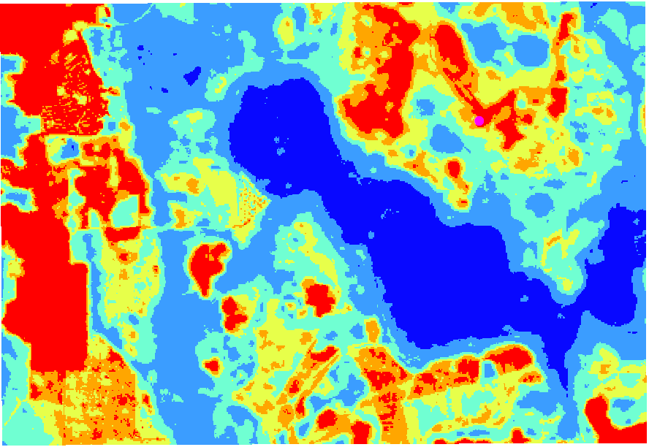
EF Maps
April 2008

Slide 15
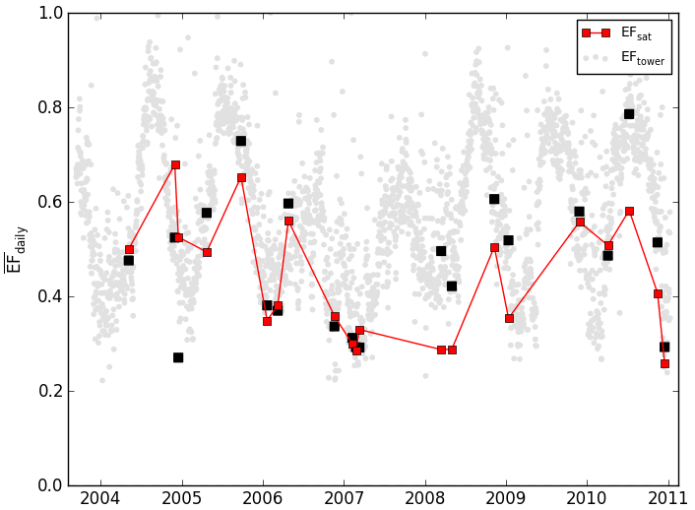
Linearly Interpolated EF
LANDSAT
16 Day Return + Clouds = Poor Temporal Resolution
Notes:
33

Slide 16
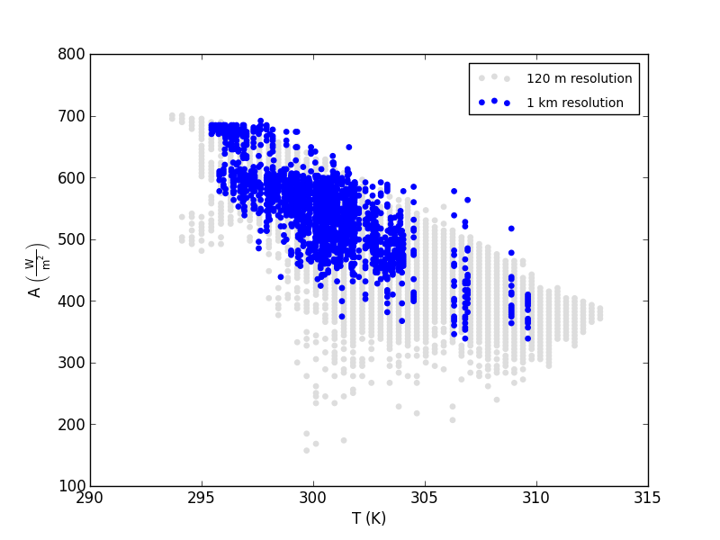
MODIS TOO COARSE
MODIS has Daily Return
But Dry Pixels Don’t Exist at this Resolution
Need
LANDSAT
(120 m)
Notes:
33

Slide 17
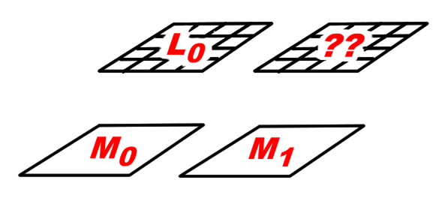
Solution? Data Fusion
Combine LANDSAT and MODIS
Use LANDSAT “Pattern” and MODIS “Change”
ΔM = M₁ – M₀
L₁ = L₀ + ΔM
Notes:
33

Slide 18
Similarity Fusion
Find MODIS Block with Most Similar ET
Use Temp Change (ΔM) from this Block

Slide 19
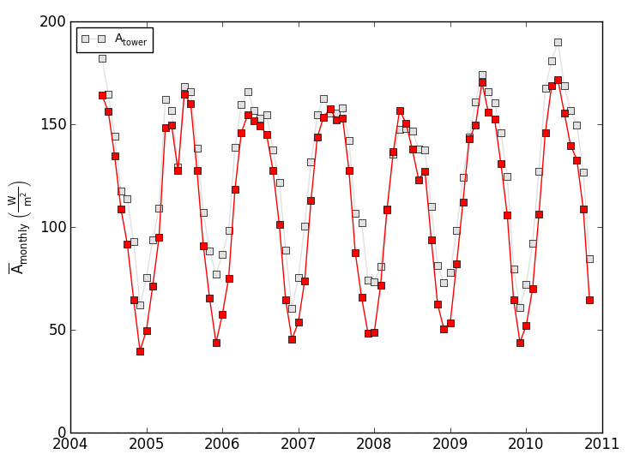
USGS Energy

Slide 20
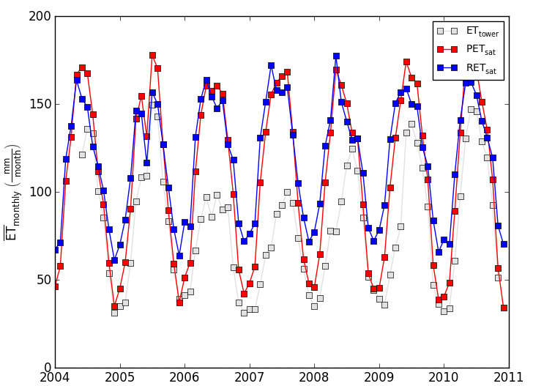
USGS PET/RET

Slide 21
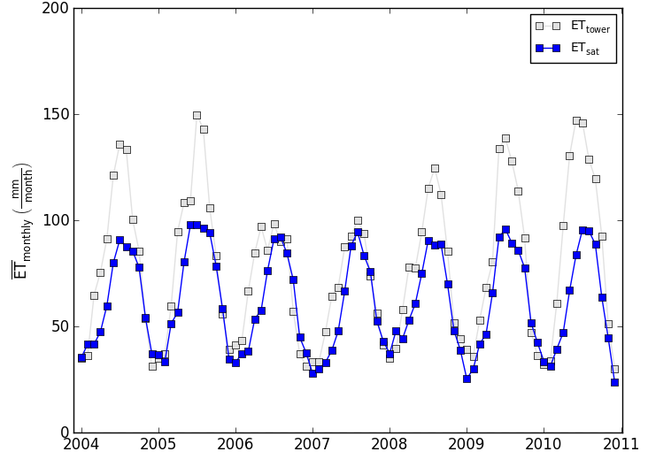
MOD16

Slide 22
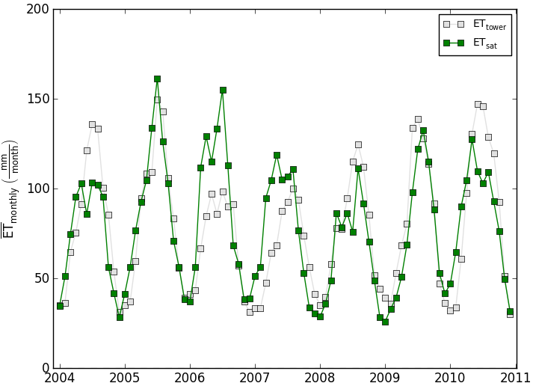
FUSION

Slide 23
Bias/MAE Errors
PET/RET has Positive Bias
MOD16 has Negative Bias
Fusion has Small Bias But MAE Similar to MOD16

Slide 24
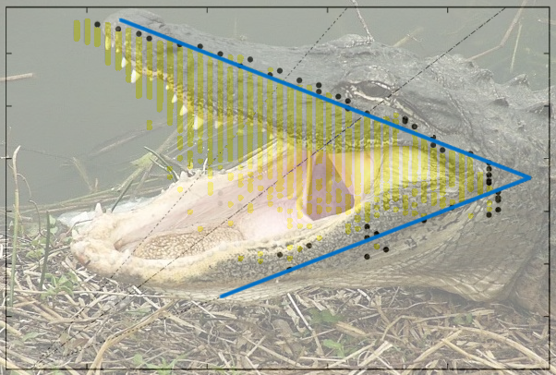
QUESTIONS

